Slide 1

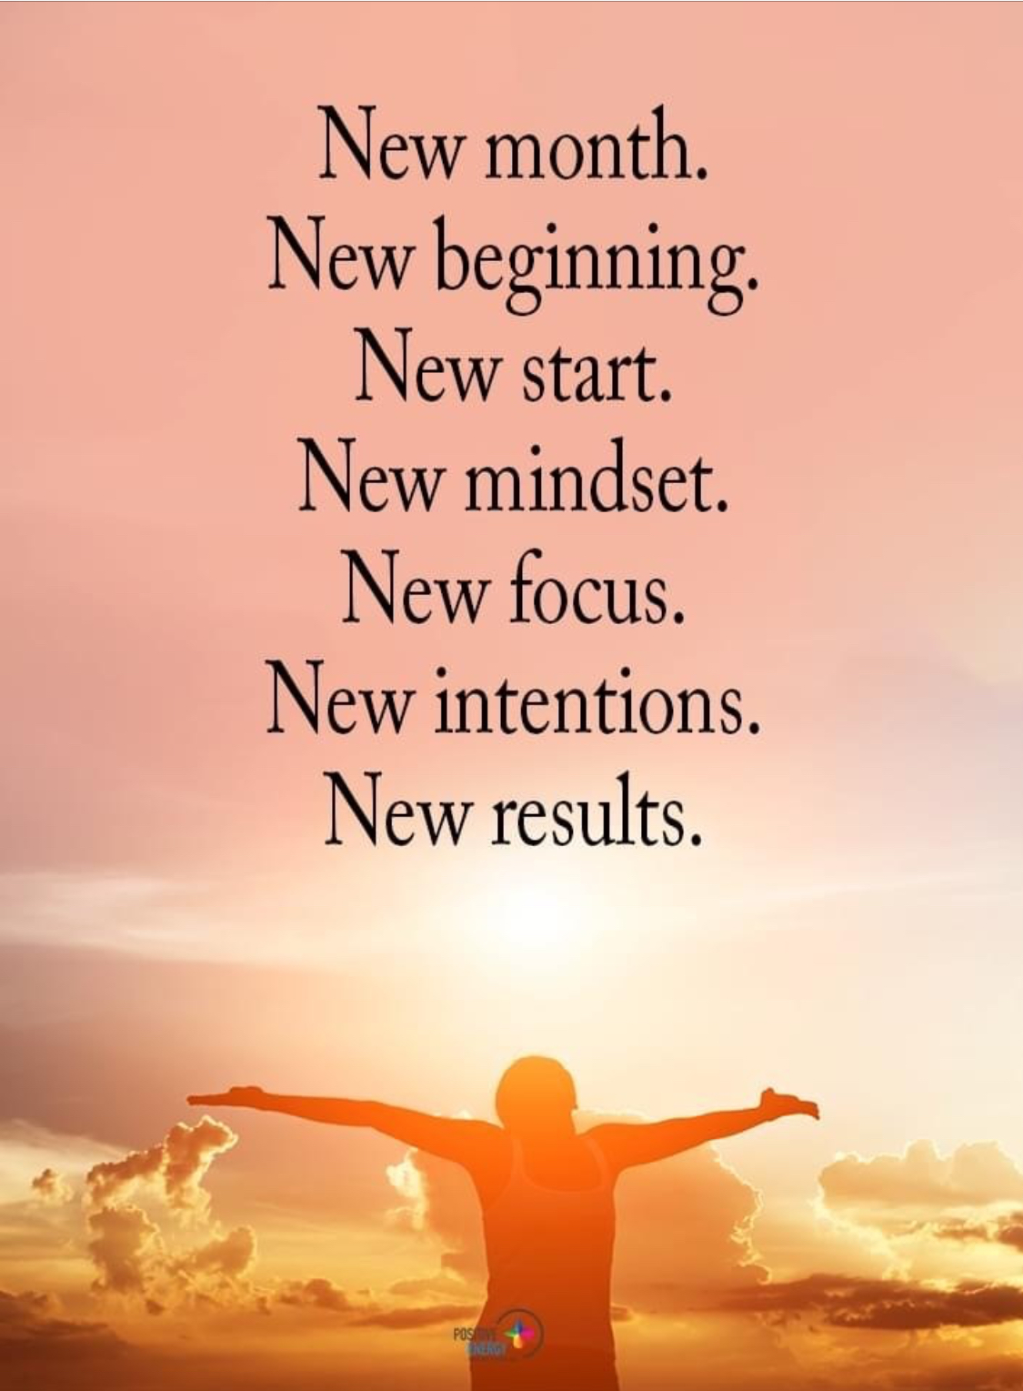
December 1st, 2020 Tuesday
Happy Christmas Season

Slide 2
December 1st, 2020 Wednesday
Happy Christmas Season
Today’s Lesson
Part I – Daily Event
Part II – Holiday Season in France

Slide 3
December 1st, 2020 Tuesday
National Christmas Lights Day
Christmas lights—lights that are hung up on Christmas trees inside, and outside on buildings, trees, and other things—are celebrated today. They were invented in the early 1880s by Edward H. Johnson, an associate of Thomas Edison.
On December 22, 1882, he lit his Christmas tree with 80 incandescent light bulbs, at his home in New York City. Prior to this time, candles were the only way to illuminate trees, and it still took many years before electric lights became the main way trees were lit, and before outside Christmas lights became popular. Lights originally were put on trees by Christians, and they symbolized Christ as being the light of the world.

Slide 4

In 1895 the first electric Christmas tree was lit at the White House. By the early 20th century some publicly displayed Christmas trees began having electric lights, although this wasn't done on a large scale until the 1950s.
Even the Rockefeller Center Christmas Tree did not have electric lights until 1956. Some businesses began putting up lights in store windows in the early 20th Century, but most everyday people couldn't even afford lights for their own Christmas trees until around 1930.
In the mid 20th century, lights separate from trees began appearing on public buildings and along streets, and individual homes began being decorated outside by owners on a large scale in the 1960s.
Eventually other types of Christmas lights, besides the bulb type, began being displayed, which included whole yard displays with animatronics and statues. Light displays are now popular on other holidays besides Christmas, such as on Easter and Independence Day.

Slide 5
How to Observe
Celebrate National Christmas Lights Day by putting up Christmas lights.
Put them up on a tree, inside around your house, or outside on your house or on trees in your yard. Maybe you even can program your light display to synchronize with music, or enter a Christmas lights contest, which some towns and cities have.
After you get your lights up, walk around your neighborhood to see what others have up, or go downtown or to public places like parks to see light displays.

Slide 6
December 2nd , 2020 Wednesday
Happy Christmas Season
Today’s Lesson
Part I – Daily Event: Rockefeller Center Christmas Tree Lighting
Part II – Holiday Season in France

Slide 7
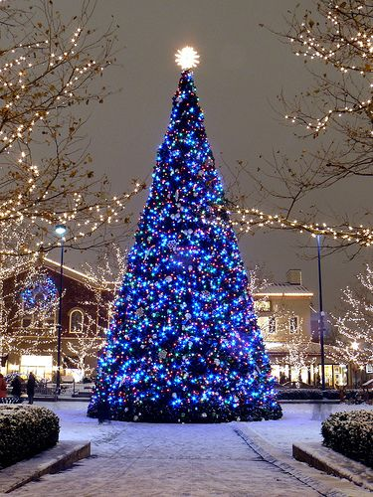
December 2nd, 2020
Wednesday
Happy Christmas Season
Rockefeller Center
Christmas Tree Lighting Day

Slide 8
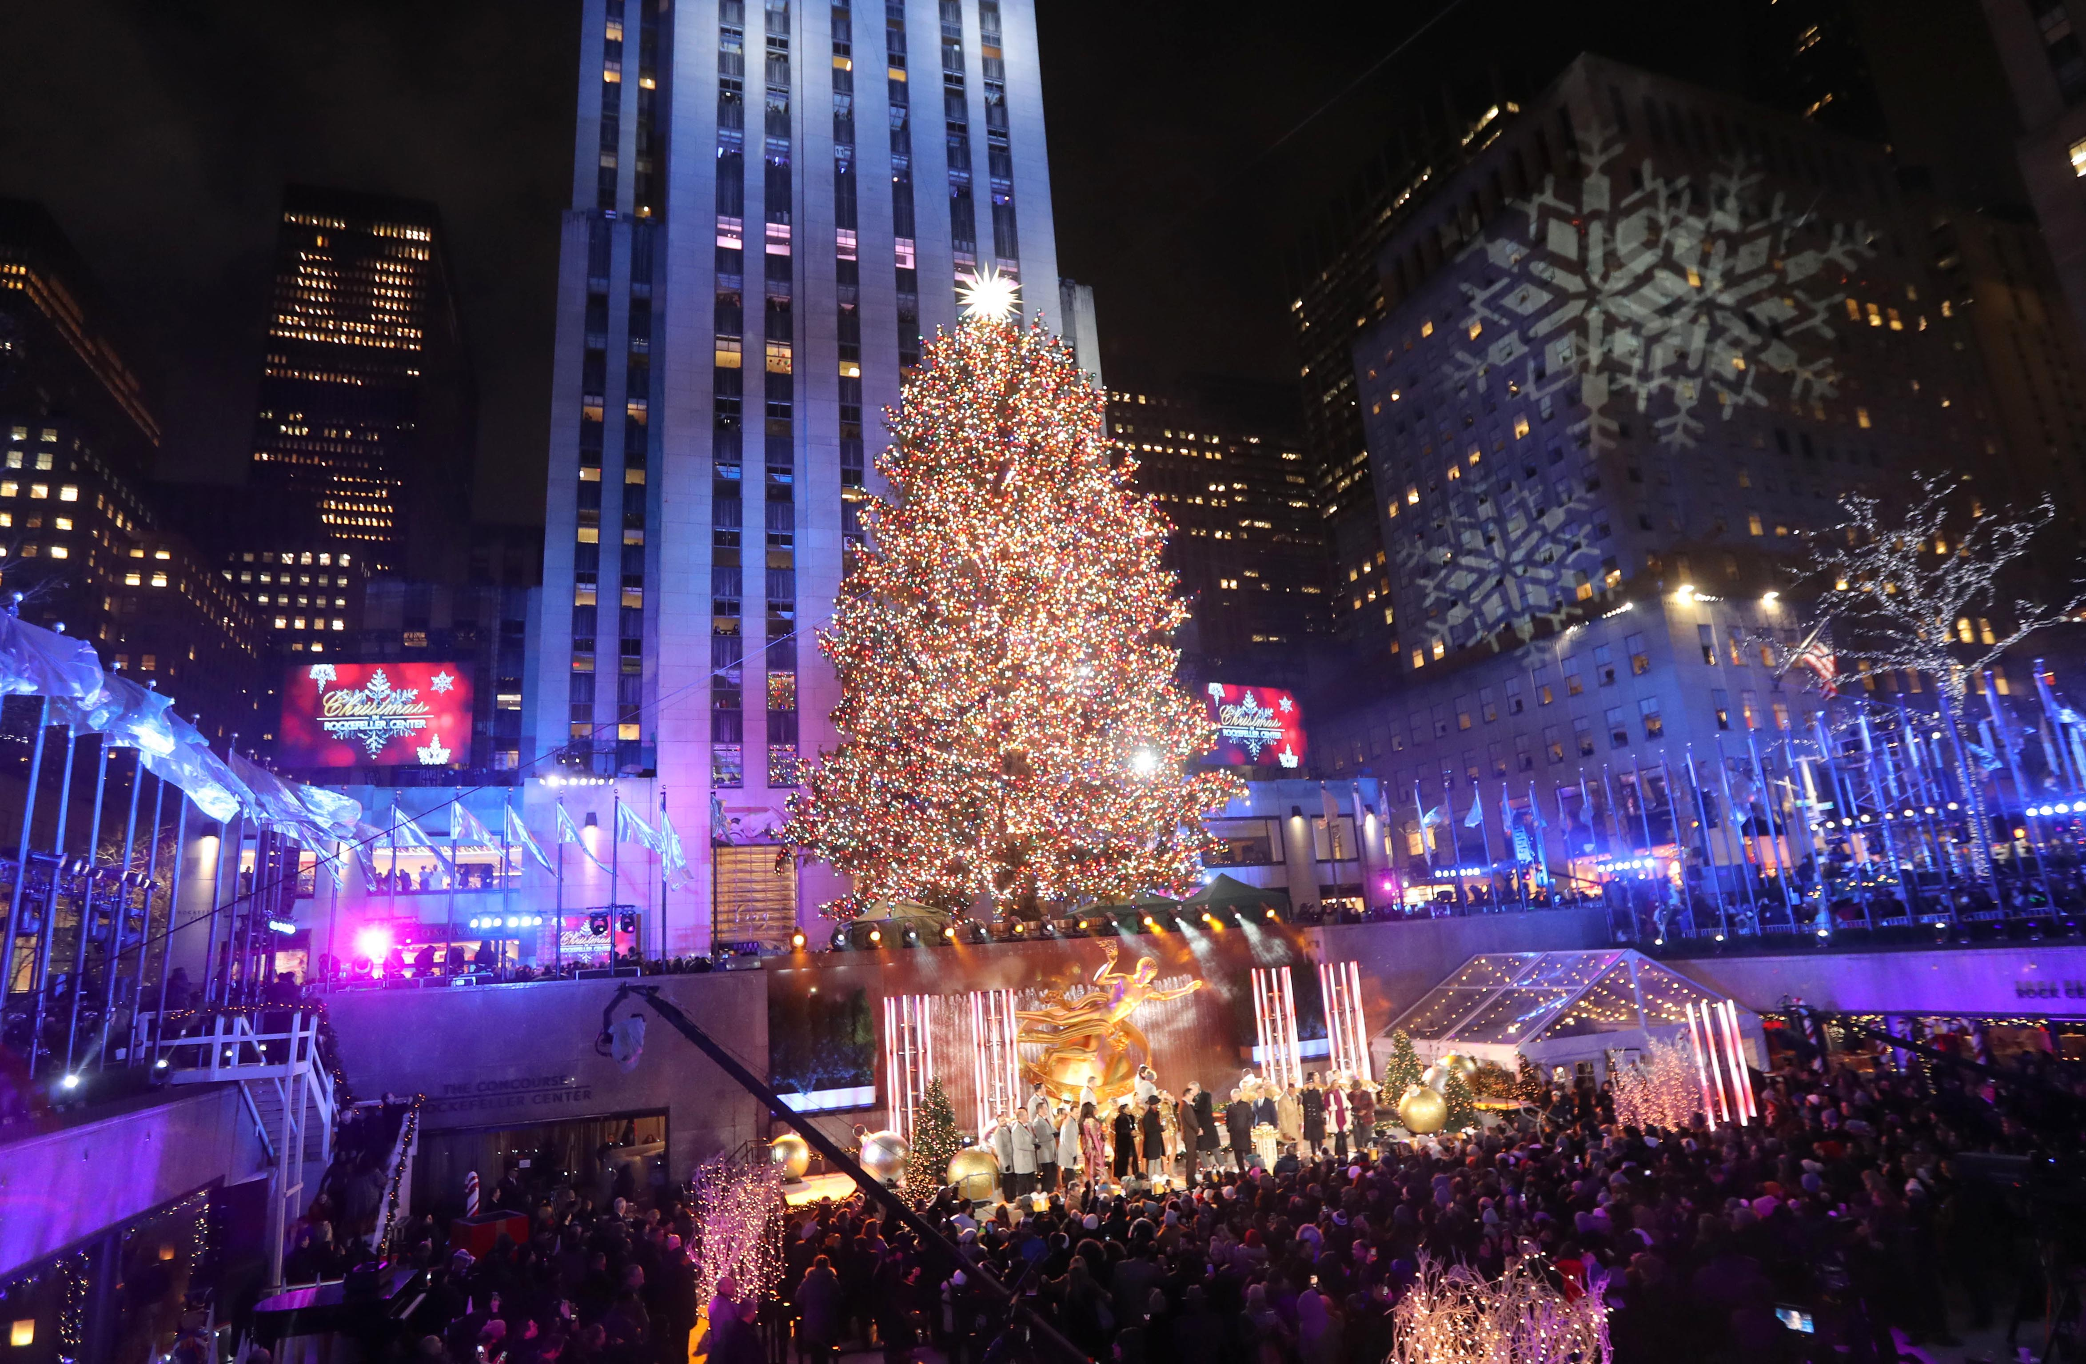

The Rockefeller Center Christmas Tree is a symbol of pride, continuity, and tradition for New Yorkers and citizens across the United States
Located just outside of the 30 Rockefeller Plaza building, between West 49th and 50th streets and Fifth and Sixth avenues, in Midtown Manhattan's Rockefeller Center, it is usually put up sometime during November.
Today, on the Wednesday after Thanksgiving, a ceremony is held and it is lit for the first time.

Slide 9
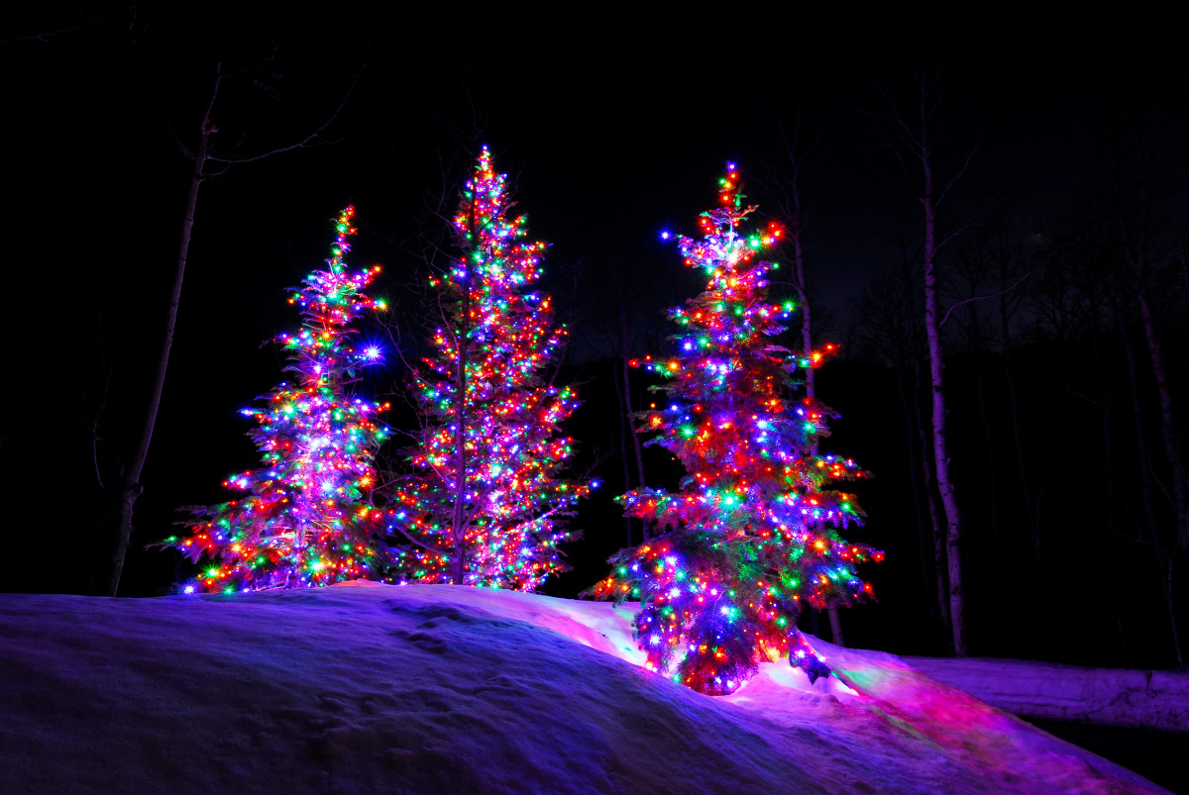
During today's ceremony, there is live entertainment and the tree is lit by New York City's mayor, who is joined by special guests.
In recent years, "Joy to the World" has been sung after the lighting. The lighting was televised for the first time in 1951, as part of The Kate Smith Show. Since 1997, the lighting ceremony has been broadcast on NBC as Christmas in Rockefeller Center.
The tree stays up until at least January 6 the following year and is then donated to Habitat for Humanity to be used for home building.

Slide 10
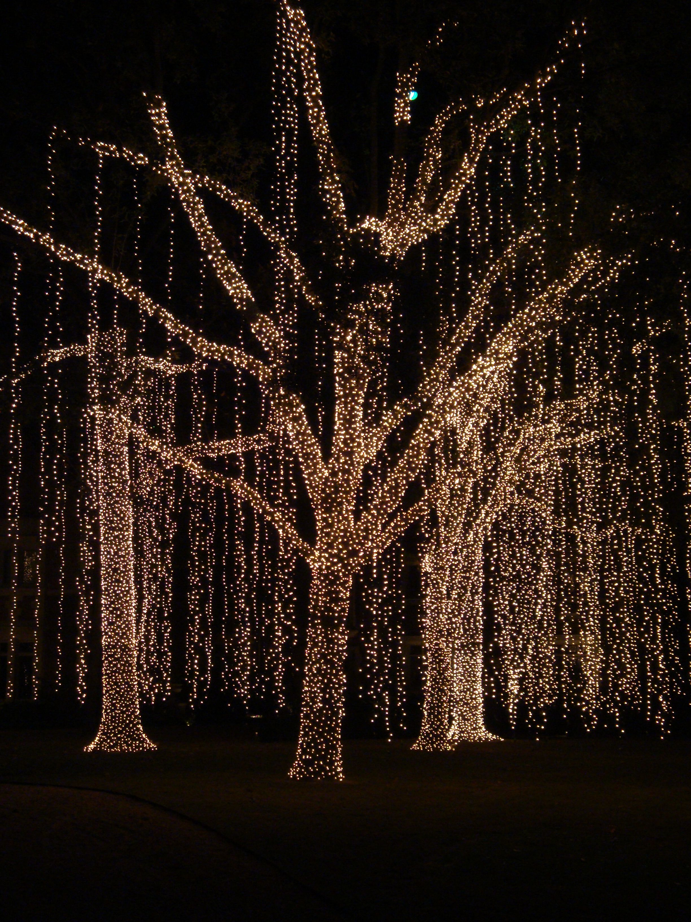
How to Observe
Watch Christmas in Rockefeller Center on NBC.
Sign up for The Rock List to get up-to-date information about the Christmas tree lighting and other events at Rockefeller Center.
Light your own Christmas tree at home.
Read The Rockefeller Center Christmas Tree or The Christmas Tree at Rockefeller Center.

Slide 11
December 2nd , 2020 Wednesday
Happy Christmas Season
Let’s continue
Part II – Holiday Season in France

Slide 12
December 3rd , 2020 Thursday
Happy Christmas Season
Today’s Lesson
Part I – Daily Event: Make A Gift Day
Part II – Holiday Season in England

Slide 13
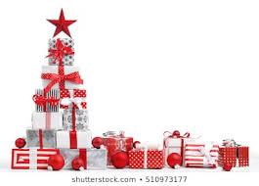
December 3rd , 2020 Thursday
Make A Gift Day!

Slide 14
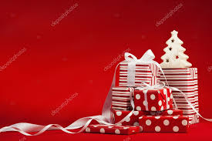
Definition of a gift
A gift or present is the transfer of something, without the need for compensation that is involved in trade.
A gift is a voluntary act which does not require anything in return. Even though it involves possibly a social expectation of reciprocity, or a return in the form of prestige or power, a gift is meant to be free.

Slide 15
Make A Gift Day!
History of Make A Gift Day
There was time, not all that long ago, when a hand-made gift was the only sort of gift you could give.
There were no major manufacturing facilities churning out the latest tchotchke that you
and every one of your friends has, instead when a gift was made, you knew that it was hand-made.

Slide 16
How to celebrate Make A Gift Day
Make A Gift Day encourages you to try your hand at producing a gift, no matter what it is.
We all have skills we can turn to producing something made with personal care and attention.
Whether you’re creating an elaborate card with the little emblems and symbols you know the recipient adores, or creating an entire outfit for that next Con, Make A Gift Day encourages you to really express yourself and your view of the recipient through arts and crafts.

Slide 17
The kinds of gifts you can make is limitless, and if you don’t possess the skill to create a gift you can certainly use this as your excuse to learn!
Start by making cupcakes for your family and friends, get some colored frosting and get a little creative, who knows what you can come up with!
Your recipient will know how much you love them and how much you value your relationship, all wrapped up in one hand made bundle.

Slide 18
December 4 , 2020 Happy Friday
Happy Christmas Season
Today’s Lesson
Part I – Daily Event: International Cheetah Day
Part II – Holiday Season in Italy

Slide 19
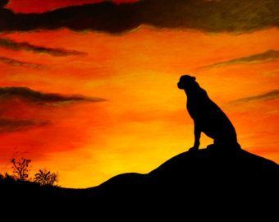
December 4, 2020 Thursday
International Cheetah Day

Slide 20
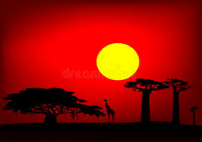
History of International Cheetah Day
As founder of the Cheetah Conservation Fund, Dr. Laurie Marker chose to commemorate Khayam, a cheetah she raised at the Wildlife Safari she ran in Oregon, by establishing December 4th as International Cheetah Day in his memory.
Khayam served as part of an important experiment determining whether or not captive Cheetahs can be taught to hunt and live in the wild on their own again. After a trip to Namibia, the experiment was proven successful, though she and Khayam returned home after observing local hunters eliminating wild cheetahs as a threat to their livelihood.

Slide 21
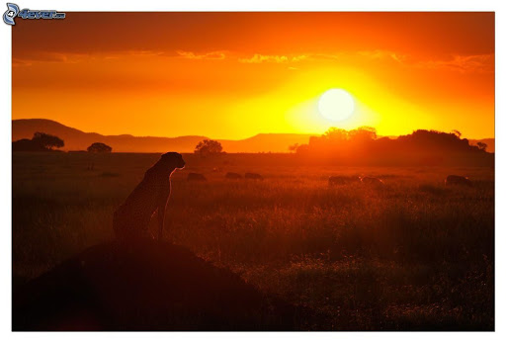
Driven by this encounter she moved to Namibia to help heal the rift between farmers and the majestic cheetah and founded the CCF in 1990.
Cheetahs are incredible animals, being the fastest land mammal in the wild today.
There are only 8,000 of these creatures left in the wild today, a number that leaves them as Africa’s most endangered feline.
Cheetah’s hold their position as world’s fastest land mammal thanks to some tricks of evolution that have perfectly adapted them for high speed.
Their full running speed is so fast that their feet only touch the ground once every 6-7 meters, and their muscular tail helps to steer them like a rudder at these high speeds.
Needless to say, once a cheetah has prey in their sites, there’s no running away.

Slide 22
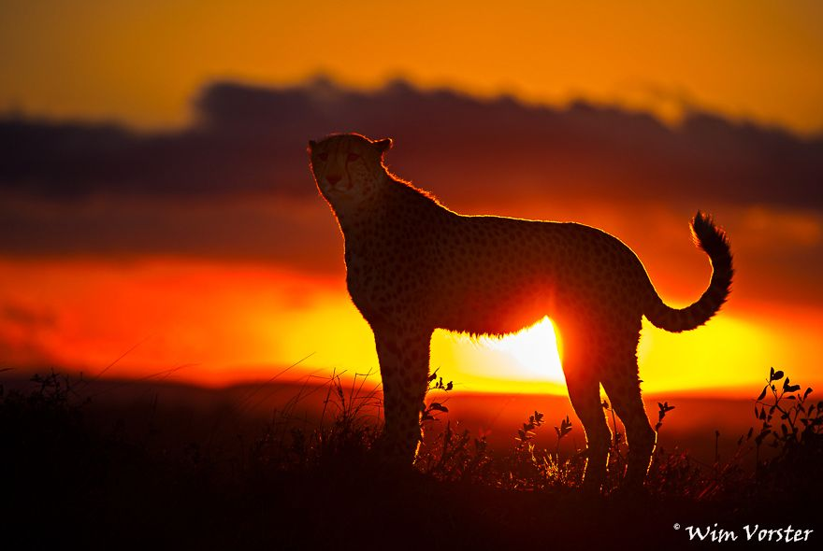
How to celebrate International Cheetah Day
Wish everyone you meet a very “Happy International Cheetah Day!”.
2. Read Freeda The Cheetah by Picklefish Press! The Kindle version is free to download on Amazon.
3. Share a cheetah image on your social media profile for the day, week or month.
4. Watch a video about Cheetah

Slide 23
December 4 , 2020 Happy Friday
Happy Christmas Season
Let’s Continue the Lesson:
Part II – Holiday Season in Italy

Slide 24
December 7, 2020 Monday
Happy Christmas Season
Today’s Lesson
Part I – Daily Event
Part II – Holiday Season in

Slide 25
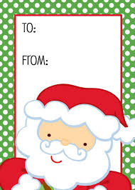

December 7, 2020 Monday
National Letter Writing Day

Slide 26
The revival of the tradition and art of handwritten letter writing is the basis of this day. Letters have been written since antiquity: they were written in ancient India, Egypt, and Sumer, and during the time of ancient Greece, Rome, and China.
Throughout history they have been written on various materials such as papyrus, animal skin, and pottery, but have long since been written on paper. The mass production of paper and advances in transportation led to an ascendancy in letter writing.

Slide 27
Family and friends were able to stay connected more easily over long distances, and in some instances letter writing became an art form, both in the substance of the text, and in its calligraphy.
With the advent of the telegraph, and later because of other forms of communication, letter writing has abated. To a large extent letter writing has today been supplanted by email and instant messages, but letters are still often used for business and official communications.

Slide 28
But not all letter writing between family and friends has disappeared, and that is why this day really exists, to keep that tradition going. Writing a letter to a loved one, instead of firing off a quick email, forces us to slow down and to deepen our thoughts.
It helps us be more creative, and maybe even a little poetic. Letters take time and effort, and they teach us patience—both while we are crafting them, and while we wait to receive one.
In the end we are left with something tangible to hold onto, that represents the essence of the person who wrote it.

Slide 29
How to Obverve
Celebrate the day by getting out some paper and writing a letter to a family member or friend.
There are no rules as long as you put your soul into it. As the holidays are coming up, this may be an opportune time to add a letter along with a holiday card you were going to send out.
Letters have served as great primary source documents for historians, giving them an opportunity to study how people lived and thought in a particularly time and place.
Letters can be inspirational and moving, and can shine a light on someone's humanity. Because of this, today could also be appropriately celebrated by reading letters. Many fascinating letters can be read online at Letters of Note, and can also be found in print form.

Slide 30
December 8, 2020 Tuesday
Happy Christmas Season
Today’s Lesson
Part I – Daily Event
Part II – Holiday Season in

Slide 31

December 8, 2020
Tuesday
National Christmas Tree Day
Make a Gift Day

Slide 32
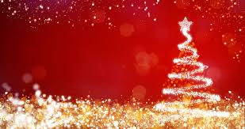
History of Christmas Tree
The Christmas tree, a prominent decoration for those who celebrate Christmas, is the focus of today's holiday. The day is often celebrated by acquiring, putting up, and decorating a Christmas tree.
Although the choice to put National Christmas Tree Day on December 8 was made by the day's creator, Jace Shoemaker-Galloway, the date does have some other connections to the Christmas tree. Today also happens to be Immaculate Conception Day, a Catholic holiday on which celebrants in some countries put up Christmas trees. December 8 is also around the time of the year that the lighting of the National Christmas
Tree takes place.
In the past, some tree farmers have also held a National Christmas Tree Day on the date as well.
Make a Gift Day

Slide 33
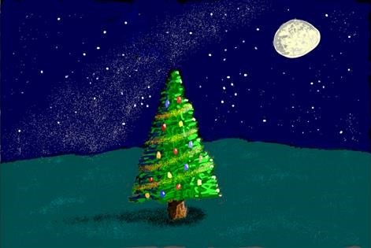
December 1st, 2020 Monday
Happy Christmas Season
The roots of the Christmas tree tradition go back to ancient pagan holidays. Pagans decorated their homes with evergreen branches during the Winter Solstice, to remind them that spring wasn't too far away. Some pagans worshipped trees as well. In ancient Rome, temples were decorated with evergreens during Saturnalia, a December holiday.
Eventually, Christians began associating Christ's birth with the winter holidays and adopted the evergreen tree, which they saw as a symbol of eternal life.

Slide 34

Christmas trees came about in western Germany. There was a German medieval play about Adam and Eve that featured a "paradise tree," a fir tree hung with apples that represented the Garden of Eden.
Germans began putting paradise trees up in their homes on Christmas Eve, the religious feast day of Adam and Eve. Besides apples, they decorated their trees with wafers, and then cookies, which symbolized Holy Communion.
Candles were also added, symbolizing Christ as the light of the world. Germans also had "Christmas pyramids." Made of wood and shaped like pyramids, they held Christmas figurines and were decorated with candles, evergreens, and a star.
By the sixteenth century, the Christmas pyramid and paradise tree were merged together to form the Christmas tree.

Slide 35
German Lutherans embraced the custom of the Christmas tree—it was widespread by the eighteenth century and considered tradition by the nineteenth century.
Christmas trees gained in popularity around the English-speaking world—including in the United States—with the release of a sketch of Queen Victoria and her family next to a Christmas tree in their home in the 1840s.
Victoria's husband, Prince Albert, had been born in Germany.
Make a Gift Day

Slide 36
Christmas trees were introduced to the American colonies during the seventeenth century.
At that time, they were looked at with suspicion by many Christians there. Some, like the Puritans, saw them as "heathen traditions." German and Irish immigrants to America helped to popularize Christmas trees there in the mid-nineteenth century.
Other countries where they were popular at that time include Poland, Switzerland, the Netherlands, and Austria. Western missionaries brought them to Japan and China in the nineteenth and twentieth centuries.
Make a Gift Day

Slide 37
December 1st, 2020 Monday
Happy Christmas Season
Christmas trees are used as both outdoor and indoor decorations and are often adorned with lights, ornaments, tinsel, and garland. Blown-glass ornaments, many being made in small workshops in Germany and Bohemia, were being sold in Britain and the United States by the 1870s. Strings of electric lights were being sold a few decades later.
Presents are often placed around Christmas trees to be opened on Christmas Eve or Christmas Day.

Slide 38
The most common trees used for Christmas trees are blue spruce, Douglas fir, balsam fir, Scots pine, white pine, noble fir, and Fraser fir.
Somewhere around 30 million real trees are cut down each year in the United States to be used as Christmas trees.
Most of them are grown on tree farms, where about 350 million trees are currently growing. In addition to real trees, around 10 million artificial trees are sold each year in the United States.

Slide 39
The first artificial Christmas trees were made in the 1880s in Germany, and started being manufactured as part of an effort to fight deforestation.
Early artificial trees were made of goose feathers that were dyed green and then attached to wire branches, which were then attached to trunks made of dowel rods.
In the 1930s, artificial trees in the United States started being made with brush bristles, and by the 1950s and 1960s, many were being made of aluminum or PVC plastic. Artificial trees have become more popular in recent years and are now mainly made of PVC plastic.
Make a Gift Day

Slide 40
Various groups in different parts of the world put up Christmas trees at different times. German tradition says that Christmas trees should be put up on December 23 or Christmas Eve, and need to be down by January 5—Twelfth Night of Christmas.
In predominantly Catholic countries such as Argentina, Italy, and Ireland, they are often put up on December 8—Immaculate Conception Day—which happens to be the same date as National Christmas Tree Day.
They are often taken down on January 6—Epiphany or on February 2—Candlemas. Christmas trees are often also put up in public places such as town squares. Each year a Christmas tree is put up in Rockefeller Center in New York City, and the National Christmas Tree is lit outside of the White House.

Slide 41
How to Observe
There is no better way to spend the day than to get a Christmas tree, put it up in your home, and decorate it.
You could cut down your own or buy a real one in a parking lot, at a store, or anywhere else where they are sold in your community.
If a real tree doesn't suit you, pick up an artificial one. Decorate your tree with lights, ornaments, garland, tinsel, or whatever else you would like.
Some other ways you could celebrate the day include watching A Charlie Brown Christmas or planning a trip to attend the lighting of the National Christmas Tree.
Make a Gift Day

Slide 42
December 9, 2020 Tuesday
Happy Christmas Season
Today’s Lesson
Part I – Daily Event
Part II – Holiday Season in

Slide 43
December 9, 2020 Wednesday
Christmas Card Day

Slide 44
History Of Christmas Card day
Christmas cards, and the man who is credited with coming up with the concept for a commercial Christmas card, Sir Henry Cole, are celebrated today.
Because he didn't have time to write all his family and friends at Christmas time, Cole, a worker at the Public Records Office in London, commissioned artist John Calcott Horsley to design a card for him, which Horsley did while living at Orestone Manor, near Torquay, in the United Kingdom.

Slide 45
History Of Christmas Card day
This first card, created in 1843, had a picture of a family celebrating Christmas together while drinking, flanked by images of people giving food and clothing to the needy.
Below, the phrase "A MERRY CHRISTMAS AND A HAPPY NEW YEAR TO YOU" was inscribed. As the cards worked well for Cole, he had a thousand of them printed, which were sold for a shilling each, making them the first mass produced Christmas cards

Slide 46
History Of Christmas Card day
In 2001, one of the original cards, which was signed by Cole himself, fetched over $30,000 at auction. It is believed that about a dozen of the original cards survive today. One of them can be viewed at the National Art Library inside of the Victoria and Albert Museum, a museum where Henry Cole was the first director.

Slide 47
History Of Christmas Card day
The tradition of Christmas cards continues to change in the twenty-first century. New printing methods allow mass-produced custom cards.
Pop up, video, and audio cards have found an audience, as have other specific types of cards. Holidays such as Hanukkah and Kwanzaa now have cards made for them as well.
Emailing instead of mailing cards, and quickly creating cards on a computer have both gained in popularity, and with the rise of social media, more people are abandoning Christmas and holiday cards altogether. Still, Americans purchase about 1.6 billion Christmas cards each year.

Slide 48
How to Observe
Celebrate the day by buying or making your own Christmas cards and mailing them out to family members and friends around the country.
If you can't choose which type of card to send, maybe you could get some replicas of Cole's first Christmas card.
The day could be spent learning more about Christmas cards by reading Christmas Cards by Michelle Higgs, or The History of the Christmas Card by George Buday; exploring Handmade Christmas and holiday cards from the Smithsonian's Archives of American Art; or by perusing White House Christmas cards through the years.

Slide 49
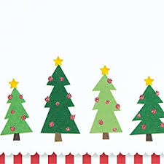


Evanna
Merry Christmas
&
Happy New year
We Wish You a happy Holiday
May your Christmas sparkle with moments of love, laughter and goodwill. And may the year ahead be full of contentment and joy. Have a Merry Christmas.

Slide 50
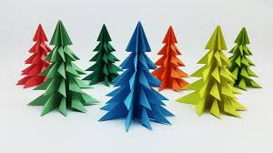


Indira:
Bells are ringing and everyone is singing, It’s Christmas! It’s Christmas! Wishing you a Merry Christmas and a Happy New Year.

Slide 51
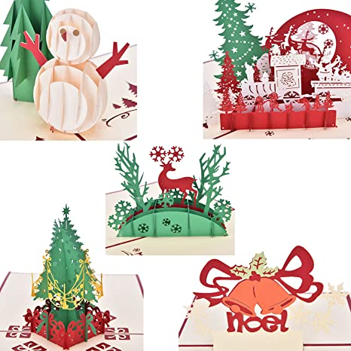




Matthew
May Santa Claus bring you lots of gifts! May your home be filled with peace and bliss!
Here’s wishing you a Merry Christmas and a Promising New Year!

Slide 52
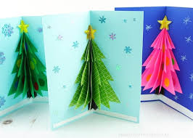




Leslie:
May your Christmas sparkle with moments of love, laughter and goodwill. And may the year ahead be full of contentment and joy. Have a Merry Christmas & Happy New Year

Slide 53
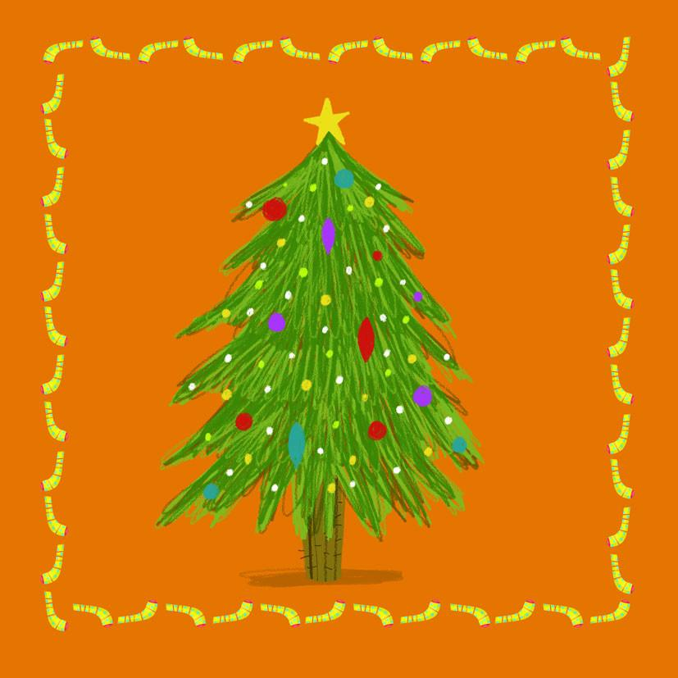
Mikaela:
Love, joy and peace are the ingredients for a wonderful Christmas. We hope you find them all this festive season. Have a Merry Christmas and a Happy New year!

Slide 54
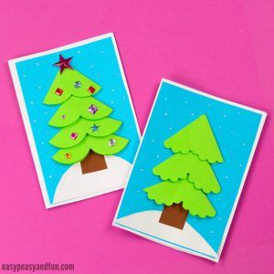

Sandra:
May Santa Claus bring you lots of gifts!
Here’s wishing you a Merry Christmas and a Promising New Year!

Slide 55
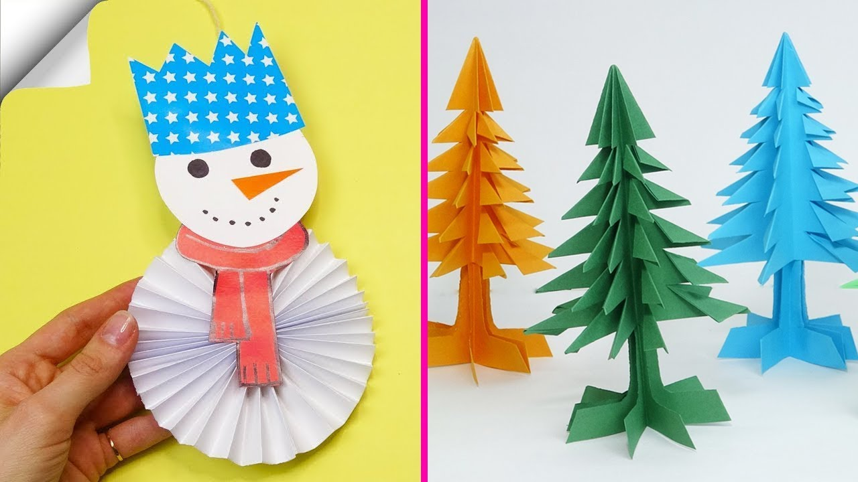



Andrew:
May you find more smiles on your face this Christmas than ever before! Wishing you a Merry Christmas and a Happy New Year! Make it grand!

Slide 56
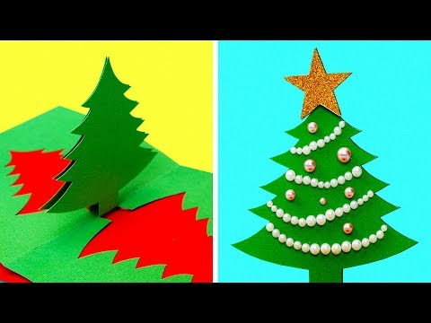
Davianna:
Wishing you a safe holiday season with the ones you love. Have a Merry Christmas and a prosperous New Year.

Slide 57
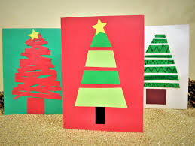




Slide 58
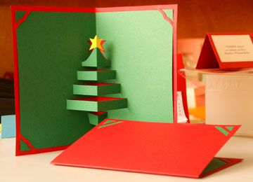
May your Christmas sparkle with moments of love, laughter and goodwill. And may the year ahead be full of contentment and joy. Have a Merry Christmas.

Slide 59
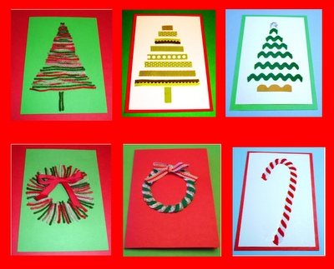
May this Christmas bring your way plenty of reasons to smile. I wish you and your family a very Happy and Joyous Christmas season.

Slide 60
December 10, 2020 Thursday
Happy Christmas Season
Today’s Lesson
Part I – Daily Event
Part II – Holiday Season in

Slide 61
December 10,
Nobel Prize Day

Slide 62





Slide 63
History of Nobel Prizes
The Nobel Prizes, considered by many to be the most prestigious awards in the world, are conferred today at the Nobel Prize Award Ceremonies, on what is known as Nobel Prize Day or The Nobel Day.
Nobel Prizes are given out in physics, chemistry, physiology or medicine, literature, economics, and peace. All but the prize in economics were stipulated in Alfred Nobel's will and began being awarded in 1901.

Slide 64
The economics prize, known officially as the Sveriges Riksbank Prize in Economic Sciences in Memory of Alfred Nobel, began being awarded in 1969. It technically is not a Nobel Prize but is associated with them.
All of the prizes must be awarded to individuals, except for the Nobel Peace Prize, which can be awarded to an institution or an individual. Nobel Prizes can be awarded to one person or can be shared by two or three people.

Slide 65
Nobel wrote in his will, which he signed in November 1895:
"All of my remaining realisable assets are to be disbursed as follows: the capital, converted to safe securities by my executors, is to constitute a fund, the interest on which is to be distributed annually as prizes to those who, during the preceding year, have conferred the greatest benefit to humankind.
The interest is to be divided into five equal parts and distributed as follows: one part to the person who made the most important discovery or invention in the field of physics;

Slide 66
one part to the person who made the most important chemical discovery or improvement; one part to the person who made the most important discovery within the domain of physiology or medicine;
one part to the person who, in the field of literature, produced the most outstanding work in an idealistic direction; and one part to the person who has done the most or best to advance fellowship among nations, the abolition or reduction of standing armies, and the establishment and promotion of peace congresses."

Slide 67
When Alfred Nobel died on December 10, 1896, the date on which Nobel Prize Day is held, he left SEK 31 million for the Nobel fund. In doing so, Nobel gave away much of his wealth.
The Nobel Foundation was established to carry out the wishes of the will, give out prizes, and administer funds. Nobel's family was opposed to the establishment of the Nobel Prize, and it took five years for the first prizes to be given out. The first Nobel Prize Day was on December 10, 1901.

Slide 68
Alfred Nobel was born on October 21, 1833, in Stockholm, Sweden. Besides establishing the Nobel Prizes, he wrote drama and poetry, had an interest in social and peace issues, was fluent in multiple languages, and was an inventor and industrialist, with his most noteworthy invention being dynamite.
He learned five languages by the age of 17 and took an interest in English poetry and literature in his youth, as well as in chemistry and physics. His father sent him for training in chemical engineering, and he traveled to Germany, the United States, and France during this time.

Slide 69
How to Observe
Watch the Nobel Prize Award Ceremonies on television or watch ceremonies from previous years.
Read Alfred Nobel's will.
Watch a documentary inspired by the Nobel Peace Prize.
If you are an educator, use lessons related to the Nobel Prizes.
Explore the Nobel Prize nomination archive.
Visit Alfred Nobel's home in Paris or Italy.

Slide 70
December 11, 2020 Happy Friday
Happy Christmas Season
Today’s Lesson
Part I – Daily Event: International Mountain Day
Part II – Holiday Season in Germany

Slide 71
December 11, 2020
International Mountain Day

Slide 72
History of International Mountain Day
History of International Mountain Day
In 1998, the United Nations General Assembly declared 2002 as the International Year of Mountains, and in a resolution in December 2002, they designated December 11 as International Mountain Day.

Slide 73
It was first held the following year. They created the day to raise awareness about the importance of mountains, saying the United Nations "encourages the international community to organize on this day events at all levels to highlight the importance of sustainable mountain development."
The Food and Agriculture Organization coordinates the celebration.

Slide 74
Why are mountains important? Twenty-two percent of the world's surface is made up of mountains, and almost a billion people live near them.
They provide food, water, and clean energy, and almost half of the world's population relies on them. They are also places of tourism and homes to cultural trails.

Slide 75
Mountains are under threat from climate change, natural disasters, land degradation, and the exploitation of land. For example, rising temperatures cause glaciers to melt, and this affects water downstream.
If nothing is done, there will be consequences for mountain communities, and to those who rely on mountains all over the world. Ninety percent of those who live near mountains live in developing countries, and already often face poverty and hunger. With the loss of their mountain resources, they will face even more dire circumstances.
.

Slide 76
If they are forced to leave, and migrate abroad or to urban areas, the culture and agriculture of mountain regions will be further upended. International Mountain Day was created in order to address these issues.
It exists to "highlight how climate, hunger, and migration are affecting highlands," and to foster sustainable mountain development

Slide 77
How to Observe
The day should be celebrated with the goal of strengthening existing and establishing new policies to promote sustainable mountain development.
Check for events taking place; some that are happening around the world are listed on the Food and Agriculture Organization website.
You can send them an email if you have an event to add to their list.

Slide 78
December 15, 2020 Happy Tuesday
Happy Christmas Season
Today’s Lesson
Part I – Daily Event: National 12-hour Fresh Breath Day
Part II – Holiday Season in Germany

Slide 79
December 12, 2020
National 12-hour Fresh Breath Day

Slide 80
National 12-Hour Fresh Breath Day is about the importance of oral hygiene and its role in keeping breath fresh for long periods of time.
The day is not so much about having a minty smelling breath as it is about the absence of bad breath, which really is what fresh breath is about.

Slide 81
In order to know how to get twelve hours of fresh breath, we need to know the problems that lead to bad breath in the first place. Bacteria live in the mouth, and they feed on leftover food particles after you eat, releasing a foul smell.
Having a dry mouth can also cause bad breath, as saliva is needed to wash out your mouth. Bad breath can be caused by gum disease.

Slide 82
How to Observe
Celebrate the day by attacking all the problems that lead to bad breath, to ensure twelve hours of fresh breath. First off, make sure to brush twice a day, and to floss to get rid of bacteria between your teeth.
Make sure to use products approved by the American Dental Association. If your tongue is coated with a disgusting looking slime, use your toothbrush or a tongue scraper to clean it off.

Slide 83
Let’s Continue
Part II- Holiday Season in Germany

Slide 85
Mouthwash can be helpful during the day if you don't have a toothbrush—it can kill some bacteria and neutralize some bad breath—but nothing can replace brushing.
During the day make sure to eat healthy foods that are good for your teeth and help produce saliva. Apples and carrots help with this, and sugar free gum can help produce saliva as well.

Slide 86
Certain foods such as coffee, garlic, and onions can cause bad breath, as can tobacco.
Other problems not directly related to the mouth can cause bad breath, such as diabetes, liver or kidney disease, or a sinus condition; if something of this nature seems to be the cause, a healthcare professional should be seen right away.

Slide 87
December 14, 2020 Happy Monday
Happy Christmas Season
Today’s Lesson
Part I – Daily Event: Free Shipping Day
Part II – Holiday Season in Germany

Slide 88
December 14, 2020
Free Shipping Day

Slide 89
Free Shipping Day is one of the many days dedicated to shopping that takes place around the holiday season, and was created for those who have procrastinated in their online gift buying.
As Christmas approaches, shoppers begin to get concerned that if they buy something online it won't arrive in time, and by mid-December, less people buy online. Over 1,000 participating retailers relieve this late shopping concern, by providing free shipping, and by guaranteeing that packages will arrive by Christmas Eve.

Slide 90
Started in 2008 by Luke and Maisie Knowles of Kinoli Inc., the first year had 250 participating companies, with some big names such as Target and JCPenney.
Starting in 2017, a coupon portion has been included on the official website, with free shipping codes and coupons.

Slide 91
How to Observe
Celebrate the day by seeing which stores are participating in the day, providing free shipping and other deals.
If you have your own company, you can participate as well!

Slide 92
December 14, 2020 Happy Monday
Happy Christmas Season
Today’s Lesson
Let’s continue
Part II – Holiday Season in Germany

Slide 93
December 16, 2020 Happy Wednesday
Happy Christmas Season
Today’s Lesson
Part I – Daily Event: Barbie and Barney Backlash Day
Part II – Holiday Season in Mexico

Slide 94

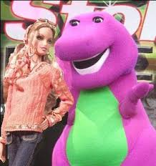
December16, 2020
Barbie and Barney Backlash Day
"

Slide 95
History of Barbie and Barney Backlash Day
“ It's the one day each year when mom and dad can tell the kids that Barbie and Barney don't exist," said the creators of Barbie and Barney Backlash Day.
Barbie and Barney have long been favorite characters for children, and parents have often seen them as being annoying or lacking in substance.

Slide 96
On today's holiday, parents and educators have the chance to tell their children what they really think of Barbie and Barney, and can let them know that the characters aren't even real.

Slide 97
In 1956, Handler bought three German Lilli dolls while vacationing in Switzerland, and used them as inspiration in creating the Barbie doll upon returning back to California.
On March 9, 1959, Barbie made its debut at the American International Toy Fair in New York City, which became Barbie's birthday, and also Barbie Day.

Slide 98
Over the years, Barbie has been seen as a positive inspiration to girls by demonstrating the many careers that young girls could pursue.
Over one billion Barbie dolls have been sold since they made their debut, and Barbie has become an American cultural icon.

Slide 99
How to Observe
If you are a parent or educator, celebrate the day by telling your students that Barbie and Barney are fake characters and don't really exist.
. Listen to A sSong About Barbie & Barney
Watch videos about Barbie & Barney

Slide 100
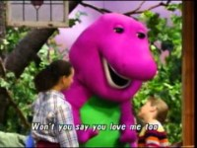

Slide 101
December 17, 2020 Happy Thursday
Happy Christmas Season
Today’s Lesson
Part I – Daily Event:
Wright Brothers Day
Part II – Holiday Season in India

Slide 102

December 17, 2020
Wright Brothers Day

Slide 103
History of Wright Brothers Day
Wright Brothers Day commemorates the first successful flight of a heavier-than-air airplane.
This feat was reached by Orville and Wilbur Wright on December 17, 1903 in North Carolina.

Slide 104
Wilbur, born in 1867, and Orville, born in 1871, were two of seven siblings. Their father Milton was a preacher who spent a lot of time on the road.
He often brought his children back toys, and in 1878 he brought Wilbur and Orville a small model helicopter. It piqued the brothers' interest in aviation.

Slide 105
Over the next few years, the brothers kept building, and got patents and contracts for their work. By 1905, they had built an airplane that could stay in the air for almost forty minutes.
Wilbur went to Europe in 1908, and he gave rides in airplanes to people of note in France. Orville arrived the following year, and they began selling their planes in Europe before returning to the United States later that year.

Slide 106
They started the Wright Company and became wealthy after selling in both Europe and the United States. Wilbur died in 1912, and Orville died in 1948.
Their contribution to aviation is incalculable, and it is only appropriate that they are officially recognized today.

Slide 107
How to Observe
Visit the Wright Brothers National Memorial in Kill Devil Hills, North Carolina.
Attend a virtual events for the day in Dayton
Visit a website about National Air and Space Museum, where the Wright Flyer is on display.

Slide 108
December 17, 2020 Happy Wednesday
Happy Christmas Season
Let’s Continue
Part II – Holiday Season in India

Slide 109
he First Amendment often protects the profane word or phrase — but not always.

Slide 110
December 18, 2020 Happy Friday
Happy Christmas Season
Today’s Lesson
Let’s Continue
Part II – Holiday Season in India

Slide 111
December 18, 2020 Happy Friday
Happy Christmas Season
Today’s Lesson
Part I – Daily Event:
International Migrants
Part II – Review Lesson: Holiday Season

Slide 112

December 18, 2020 Happy Friday
International Migrants Day

Slide 113


International Migrants Day is observed annually on December 18th since 2000.

Slide 114

The observance of International Migrants Day this year focuses on the stories of social communication, which are as unique as each of the 272 million migrants living new lives and building new communities in every corner of the globe.

Slide 115

We learn together, create together, work together, sing, dance and play together.
We live together. That is the meaning of International Migrants Day and its message.

Slide 116

The International Organization for Migration salutes migrants and the communities, which they join and remake through mutual effort.
We salute and support them. We pledge to make the future we believe is arriving for all of us. WeTogether!

Slide 117
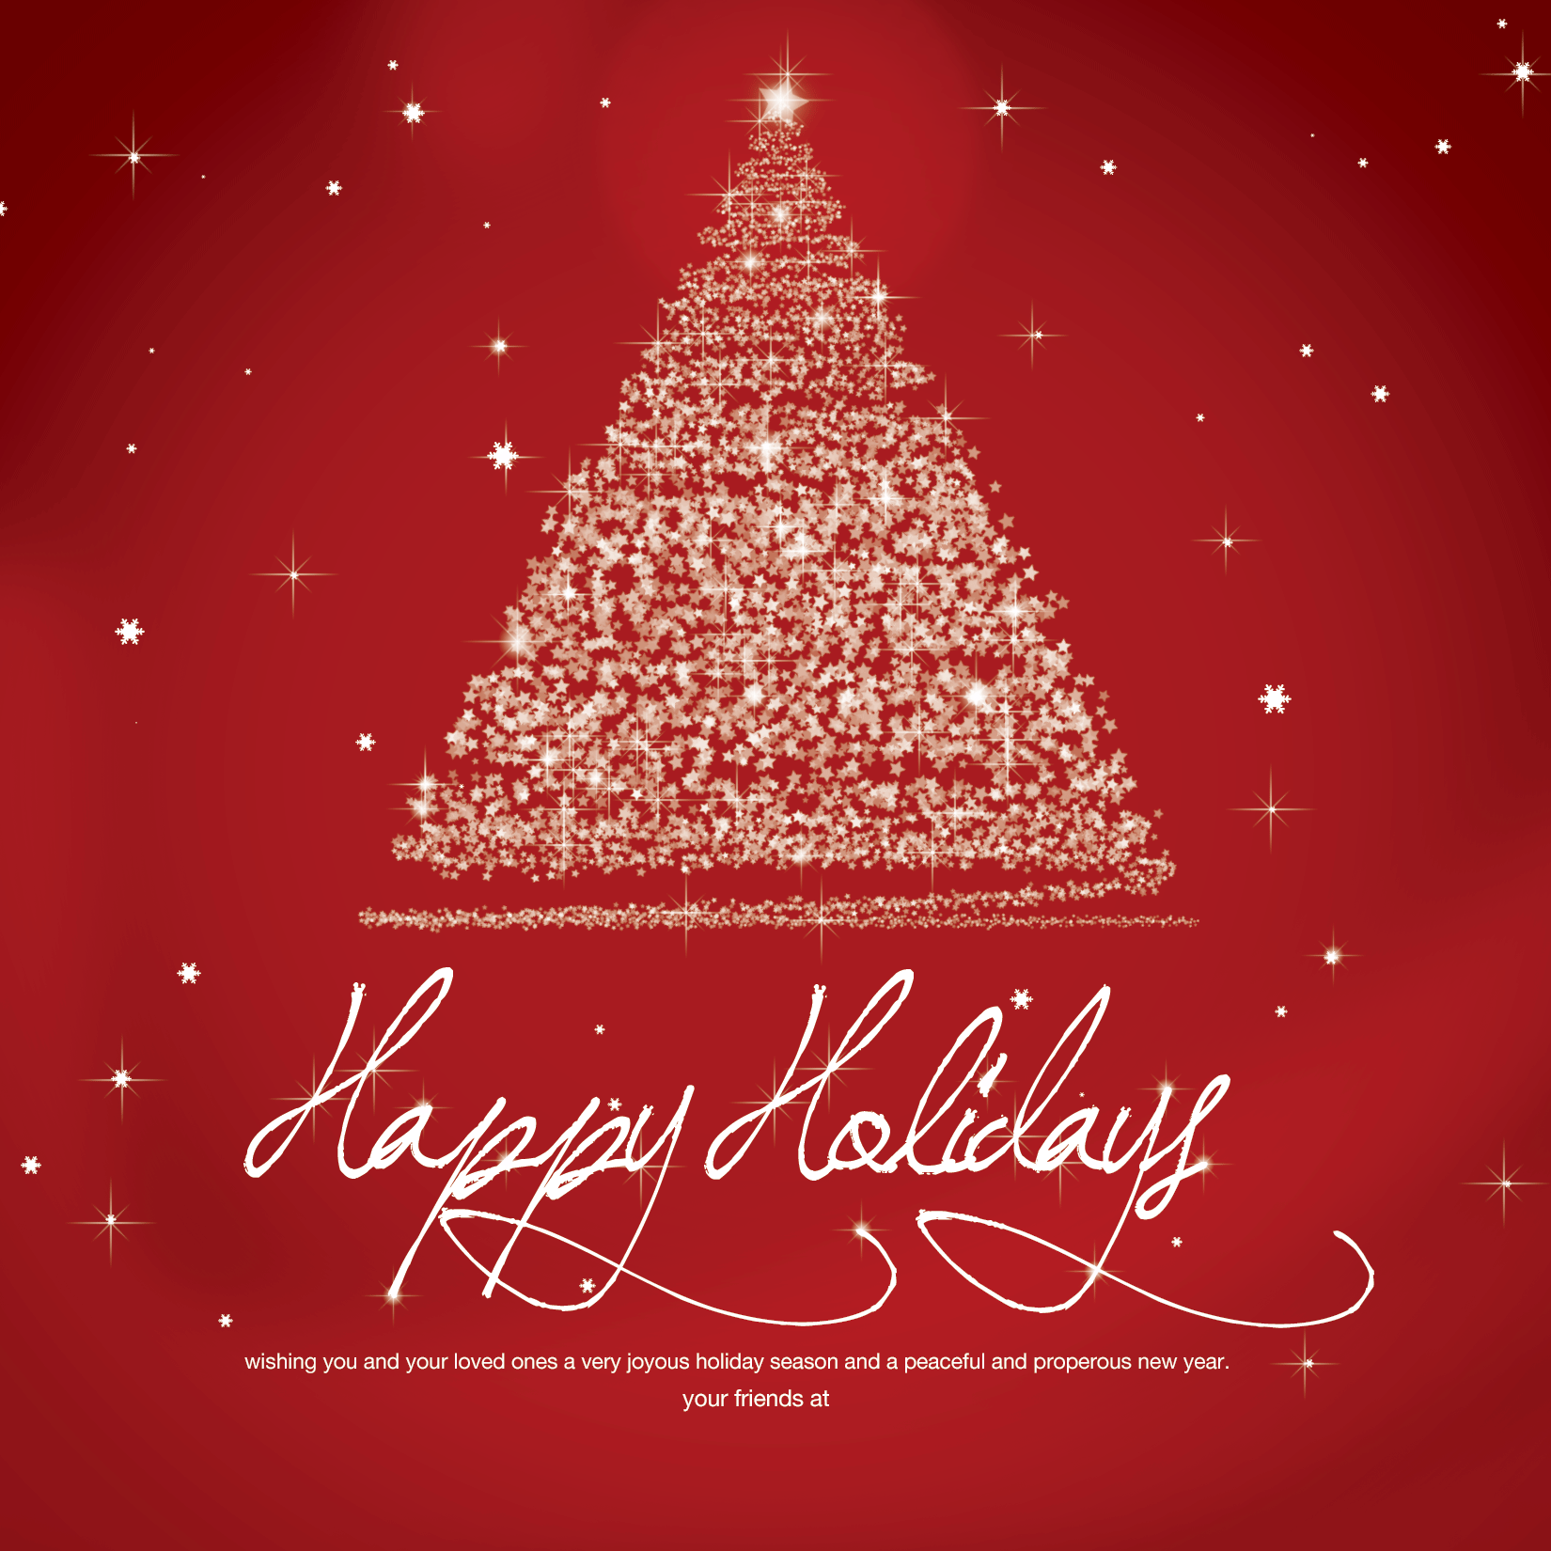
To All Immigrants Around the World
Merry Christmas
& Happy New Year

Slide 118

Let’s Continue
Part II- Review Lesson: Holiday Season

Slide 119
Exercise: Matching the following answers:
There are 13 desserts for Christmas dinner in
2. Poinsettia plants originated in
3. Glass Christmas ornament was invented in
England
Mexico
Germany

Slide 120
4. Christmas Carolers ring hand bell and sing Christmas songs in front of people’s house in
5. In ( ) , people created beautiful pattern, called Rangoli, on the floor using brightly colored with rice powders and sand.
6. “Merry Christmas” in ( ) says, “ Feliz Navida”
England
India``````````````````````````````````````````````````````````````````````````````````````````````````````````````````````````````````````````````````````````````````````````````````````````````````````````````````````````````````````````````````````````````````````````````````````````````````````````````````````````````````````````````````````````````````````````````````````````````````````````````````````````````````````````````````````````````````````````````````````````````````````````````````````````````````````````````````````````````````````````````````````````````````````````````````````````````````````````````````````````````````````````
Spanish

Slide 121

December 18, 2020 Happy Friday
Happy Christmas Season
Thank you for all your support
Merry Christmas & Happy New Year!

Slide 122


Slide 123
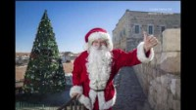

Slide 124
In 2019, the number of migrants globally reached an estimated 272 million,

Slide 131


Slide 138


Slide 139
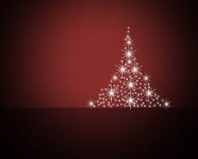

Slide 140
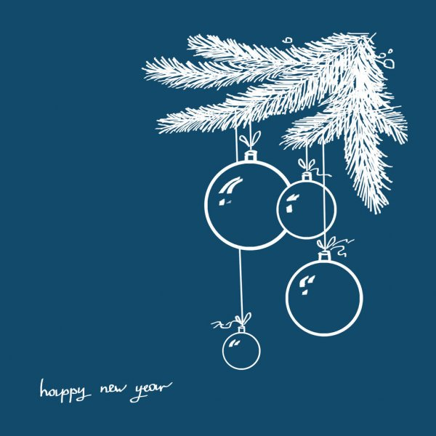

Slide 141
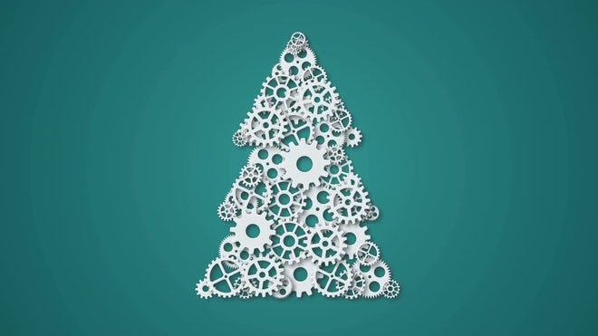

Slide 146


Slide 147
December 1st, 2020 Monday
Happy Christmas Season

Slide 148
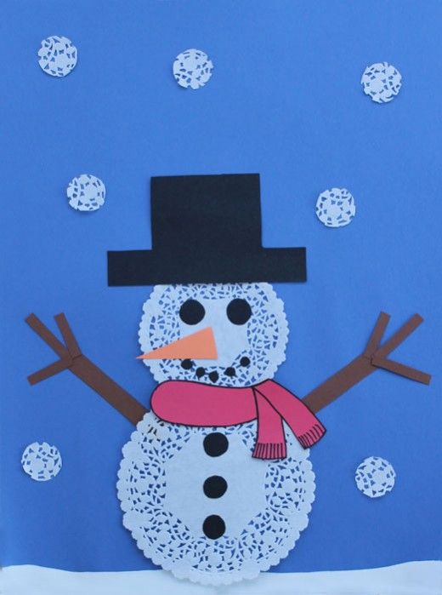

Slide 149
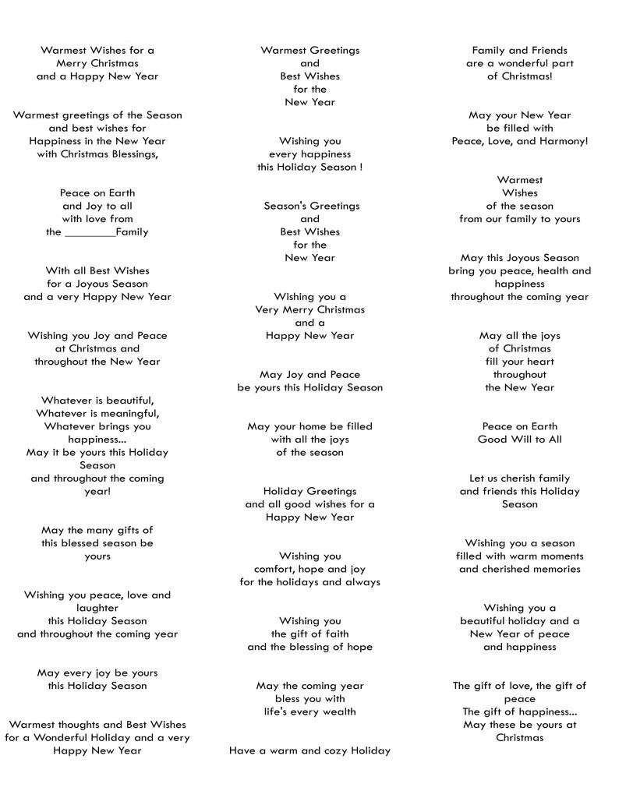

Slide 150



Slide 156
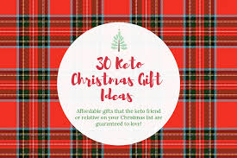

Slide 157
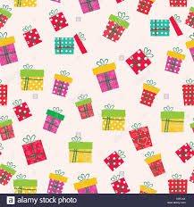

Slide 163
Make a Gift Day

Slide 170
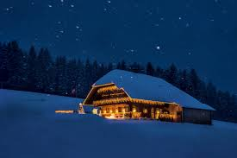
November 4, 2020 Thursday
International Cheetah Day
Make a Gift Day

Slide 171
November 4, 2020 Thursday
International Cheetah Day
Make a Gift Day

Slide 172
November 4, 2020 Thursday
International Cheetah Day
Make a Gift Day

Slide 173
November 4, 2020 Thursday
International Cheetah Day
Make a Gift Day

Slide 174
December 4 , 2020 Friday
Happy Christmas Season
Today’s Lesson
Part I – Daily Event
Part II – Holiday Season in

Slide 176
December 7, 2020 Monday
Letter Writing Day
Make a Gift Day

Slide 177
Make a Gift Day

Slide 178
Make a Gift Day

Slide 179
Make a Gift Day

Slide 180
Make a Gift Day

Slide 181
Make a Gift Day

Slide 182
Make a Gift Day

Slide 183
Make a Gift Day

Slide 184
Make a Gift Day

Slide 195
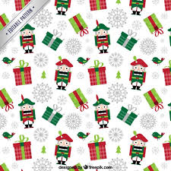
December 1st, 2020 Monday
Happy Christmas Season

Slide 196
December 1st, 2020 Monday
Happy Christmas Season

Slide 197
December 1st, 2020 Monday
Happy Christmas Season

Slide 198
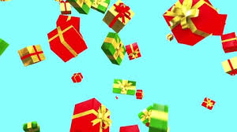
December 1st, 2020 Monday
Happy Christmas Season
When is this holiday celebrated?
This holiday is celebrated annually on December 3 every year.

Slide 199
December 1st, 2020 Monday
Happy Christmas Season
What is this holiday about?
It's all about making a gift instead of buying a gift!
Many people would much rather recieve a homemade gift than a bought gift. When a person takes the time to make a gift, they put their heart and soul into that gift, therefore the gift becomes more meaningful.
This holiday is a great holiday to promote the idea of making gifts and remind everyone to find those crafty and artistic abilities that we have and make a gift for someone.

Slide 200
December 1st, 2020 Monday
Happy Christmas Season

Slide 201
December 1st, 2020 Monday
Happy Christmas Season

Slide 202
December 1st, 2020 Monday
Happy Christmas Season

Slide 203
December 1st, 2020 Monday
Happy Christmas Season

Slide 204
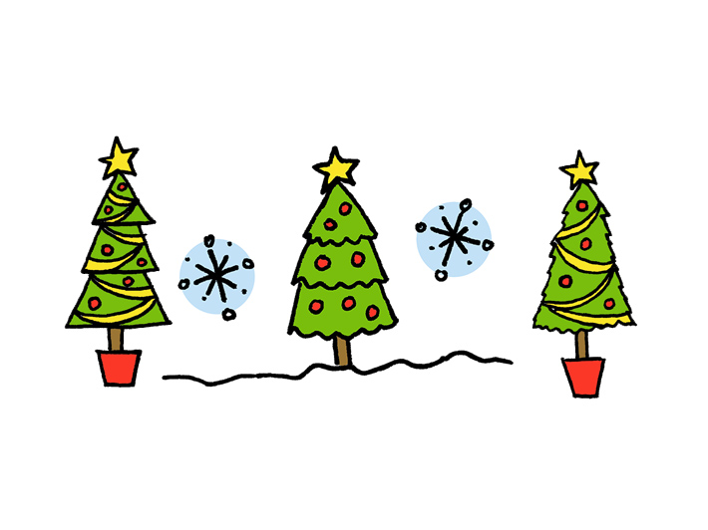
December 1st, 2020 Monday
Happy Christmas Season

Slide 205
December 1st, 2020 Monday
Happy Christmas Season

Slide 206
December 1st, 2020 Monday

Slide 207
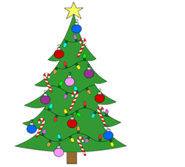
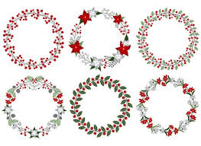

Slide 208
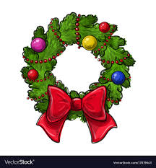

Slide 209
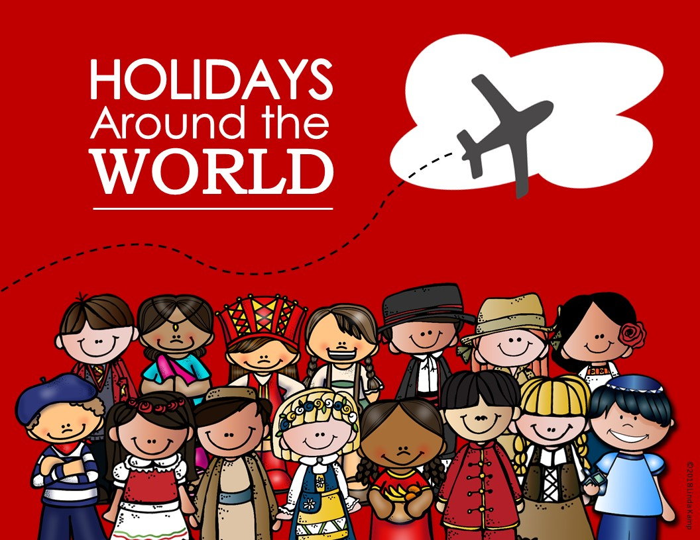

Slide 210
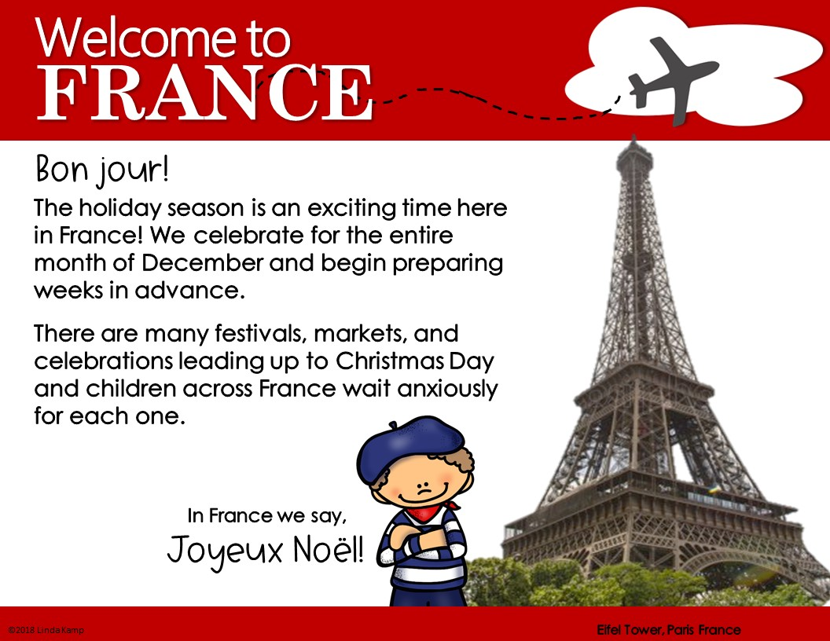

Slide 211
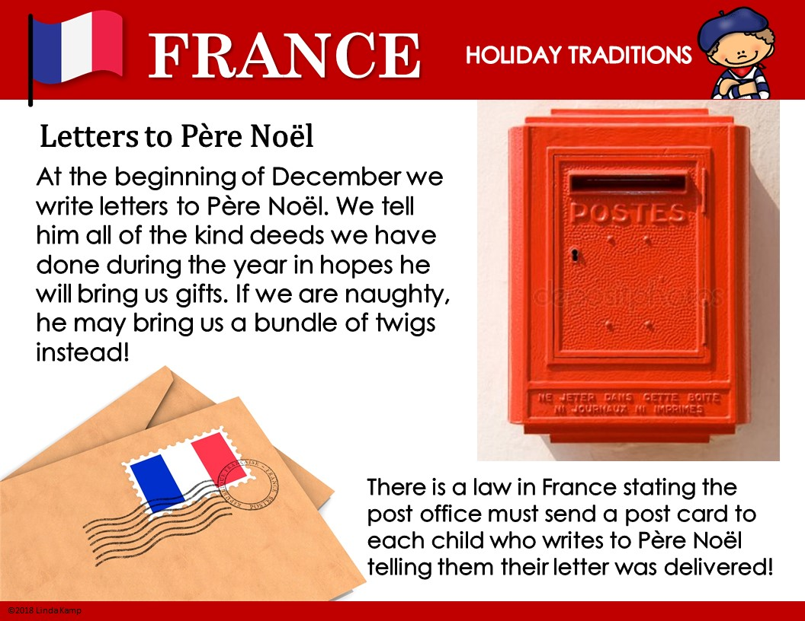

Slide 212
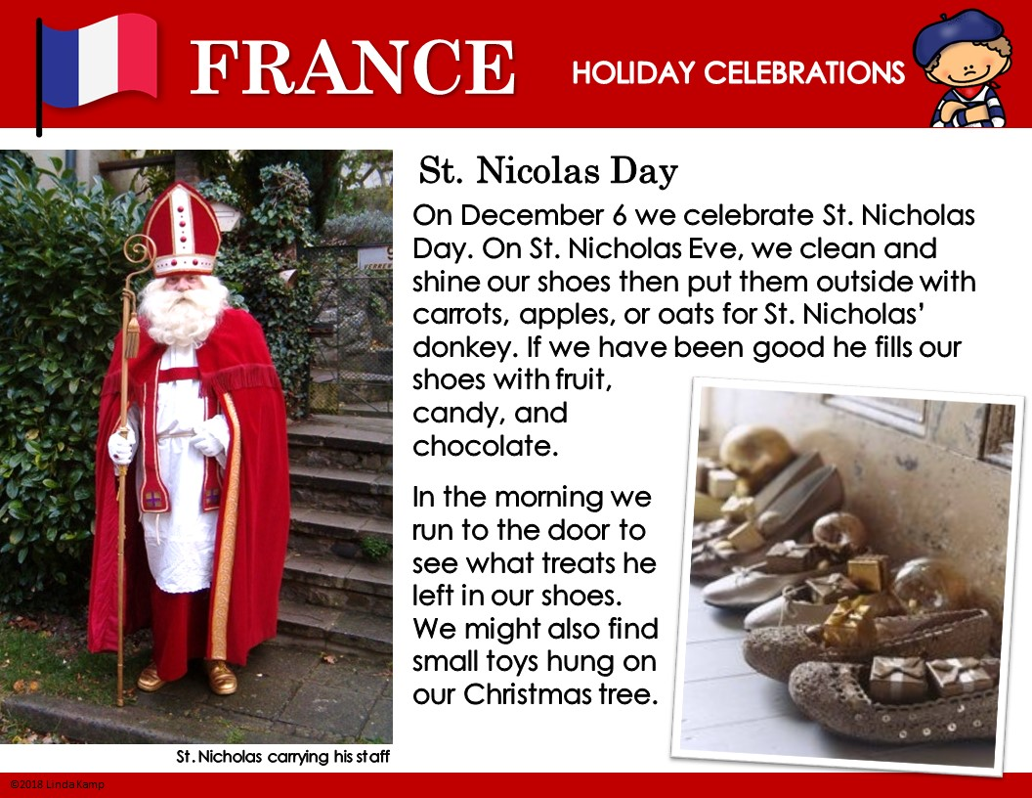

Slide 213
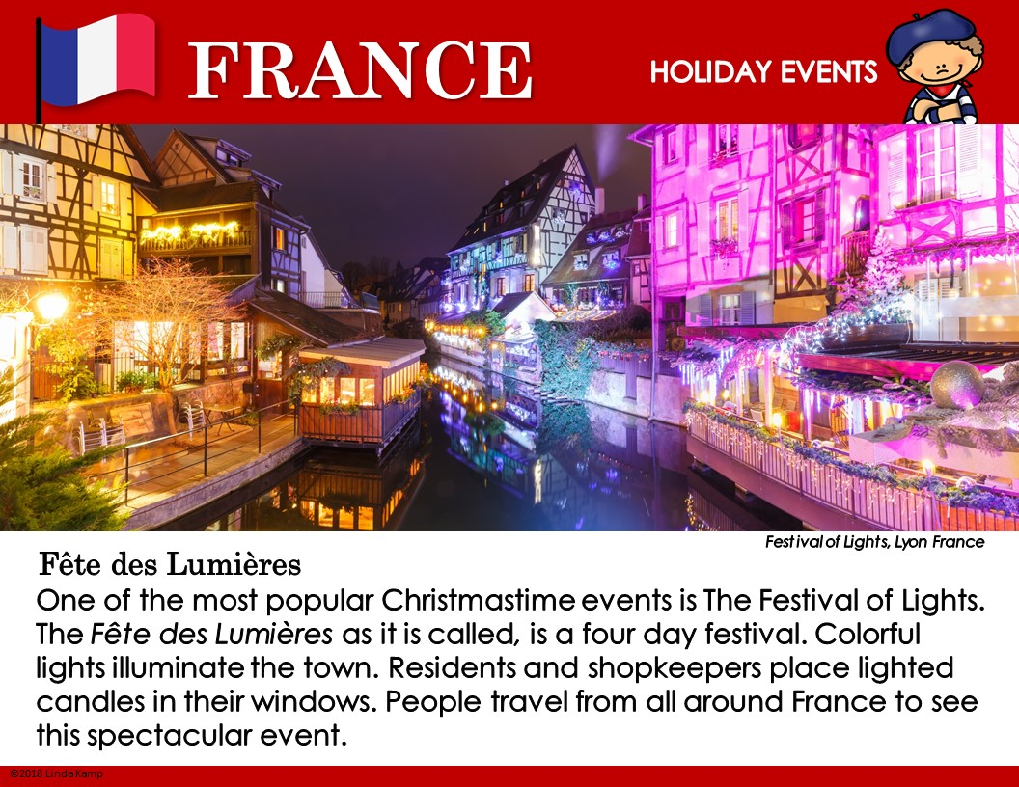

Slide 214
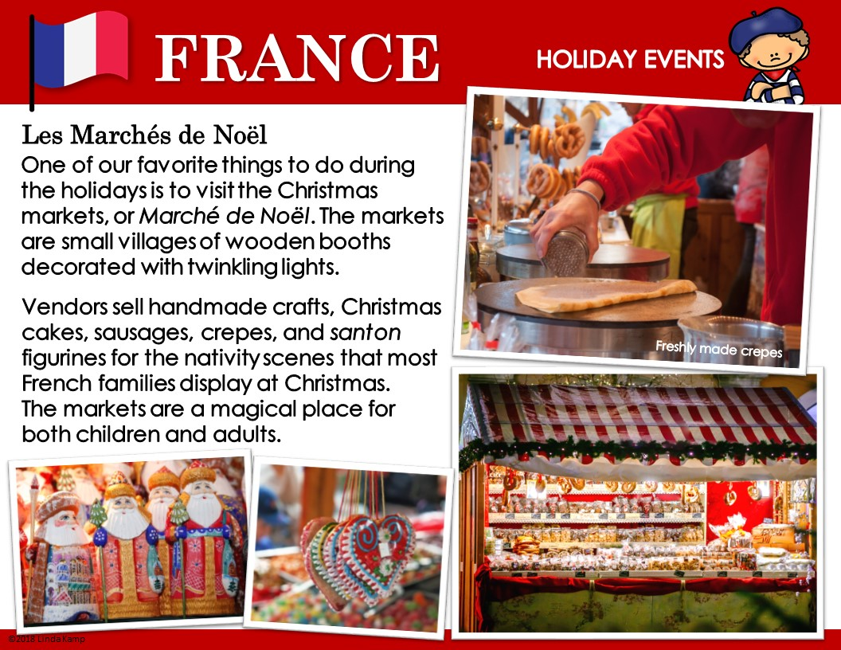

Slide 215
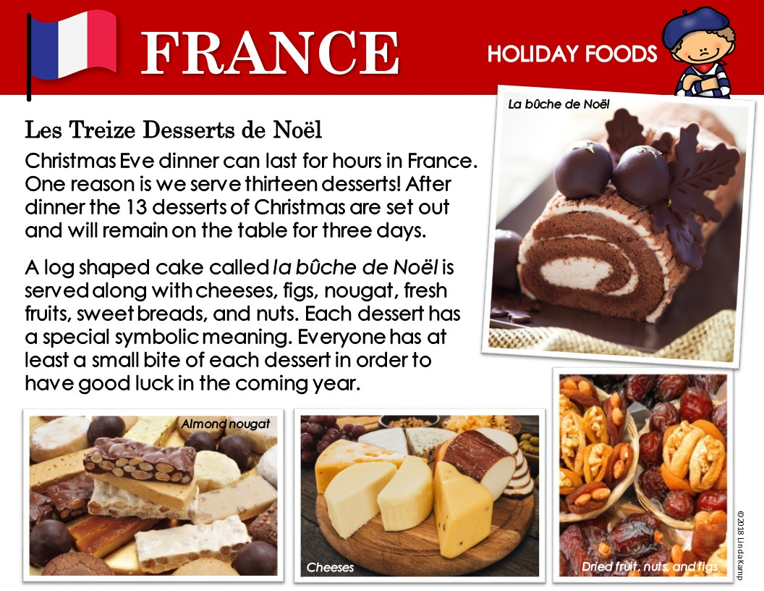

Slide 216


Slide 217


Slide 218


Slide 219


Slide 220


Slide 221


Slide 222


Slide 223


Slide 224


Slide 225


Slide 226


Slide 227


Slide 228


Slide 229


Slide 230


Slide 231


Slide 232


Slide 233


Slide 234


Slide 235


Slide 236


Slide 237


Slide 238


Slide 239


Slide 240


Slide 241


Slide 242


Slide 243


Slide 244


Slide 245


Slide 246


Slide 247


Slide 248


Slide 249


Slide 250


Slide 251


Slide 252


Slide 253


Slide 254


Slide 255


Slide 256


Slide 257


Slide 258


Slide 259


Slide 260


Slide 261


Slide 262


Slide 263


Slide 264


Slide 265


Slide 266


Slide 267


Slide 268


Slide 269


Slide 270


Slide 271


Slide 272


Slide 273


Slide 274


Slide 275


Slide 276


Slide 277


Slide 278


Slide 279


Slide 280


Slide 281


Slide 282


Slide 283


Slide 284


Slide 285


Slide 286


Slide 287


Slide 288


Slide 289


Slide 290


Slide 291


Slide 292


Slide 293


Slide 294


Slide 295


Slide 296


Slide 297


Slide 298


Slide 299


Slide 300


Slide 301


Slide 302


Slide 303


Slide 304


Slide 305


Slide 306


Slide 307


Slide 308


Slide 309


Slide 310


Slide 311


Slide 312


Slide 313


Slide 314


Slide 315


Slide 316


Slide 317


Slide 318


Slide 319


Slide 320


Slide 321


Slide 322


Slide 323


Slide 324


Slide 325


Slide 326


Slide 327


Slide 328


Slide 329


Slide 330


Slide 331


Slide 332


Slide 333


Slide 334


Slide 335


Slide 336


Slide 337


Slide 338


Slide 339


Slide 340


Slide 341


